Slide 1

AMAZON ASSOCIATION MINING
University of Hertfordshire (Data Science Project Club)

Slide 2
MEET THE TEAM!
The Data Science Project Club (Amazon Association Mining) is made up of the following :
Paul Moggridge (Team Lead)
Eloho Mukoro
Sahil H Mulani
Sonam Agarwal
Muhammad Shaheer Zahid

Slide 3
INTRODUCTION
The aim of the project is perform association mining on records of the various reviewed products purchased by an Amazon customer and identify the various products that are bought based on the association rules.
Objective:
This project would aid the decision making of the Business strategist in Retail companies and improve the efficiency and revenue growth of the company or organization.
The project requires knowledge in python, the use of WEKA and the apropriate association mining technique for the implementation of the project.
Notes:
Some application of association mining can be applied in customer segementation, social media profiling, system recommendation and others.

Slide 4
ASSOCIATION MINING
Association mining is a data mining technique that aims to discover associations or patterns among variables in large datasets.
Goal: It is to identify items that are frequently purchased together and using those relationships to make predictions or decisions.
Common Association Mining Algorithms:
the Apriori algorithm: generating frequent item sets (sets of items that appear together frequently)
the FP (Frequent Pattern): finds association and correlations among items using FP tree structure in a dataset for decision making.
Applications: Association mining has applications in various fields, including retail, healthcare, finance, and social network analysis.
It is important to note that association mining is a descriptive technique that can reveal correlations but not causation. Therefore, caution should be exercised when interpreting the results of association mining and making decisions based on them.

Slide 5
FREQUENT PATTERN (FP) ALGORITHM
The FP-Growth (Frequent Pattern) algorithm is a popular algorithm for association rule mining. It works by constructing a tree-like structure called a FP-tree, which encodes the frequent item sets in the dataset. The FP-tree is then used to generate association rules.
FP-Growth Steps:
1. Find the minimum support of each item.
2. Order frequent itemset in descending order.
3. Draw an FP tree.
4. Minimum frequent pattern from the FP tree.
Pros:
It is a faster association algorithm especially for large datasets because it takes only 2 passes over the dataset.
It uses a FP tree-like structure which is memory efficient.

Slide 6

AMAZON USE CASE SCENARIO
Amazon Customer Reviews (a.k.a. Product Reviews) is one of Amazon’s iconic products. In a period of over two decades since the first review in 1995, millions of Amazon customers have contributed over a hundred million reviews to express opinions and describe their experiences regarding products on the Amazon.com website with over 130+ million customer reviews are available.
Summary:
The dataset was captured from 1995 to 2015.
It has over 130+ million customer reviews.
It has over 2K+ customer reviews from 5 countries.
It is available in 2 formats (TSV and PARQUET).
The dataset has the customer ID, the product details and review details.

Slide 7
TECHNICAL REQUIREMENTS AND SPECIFICATIONS
Tools and application:
WEKA
Python Library
mlxtend: This is a library for implementing various machine learning algorithms and tools in Python, including association rule mining. It provides functions for reading and manipulating transactional data, as well as for generating association rules and evaluating their quality.
Minimum Specifications:
Download TSV and Data Tranformation | Generate Association Rules
AMDA 1068100K 2G Swap/Page file 16G Main Memory RAM Ubuntu OS 4.4GHz | Device name COM-1J112-020 Full device name COM-1J112-020.herts.ac.uk Processor Intel(R) Core(TM) i7-9700 CPU @ 3.00GHz 3.00 GHz Installed RAM 32.0 GB (31.8 GB usable) Device ID 92641DBA-5C44-4FA9-9C97-FD3A7E302B7A Product ID 00328-10000-00001-AA434 System type 64-bit operating system, x64-based processor Pen and touch No pen or touch input is available for this display

Slide 8
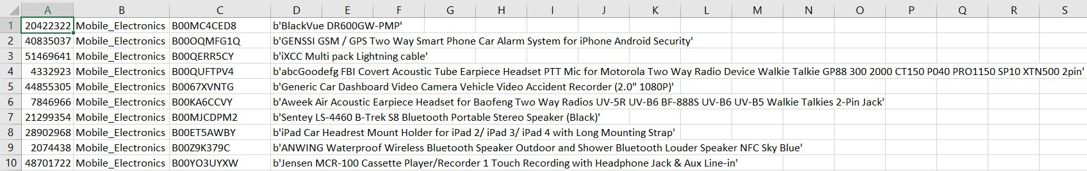
ASSOCIATION MINING PROCESS
All reviewed products had the files saved in tsv.gz format.
Example, this link had reviews for watches only (https://s3.amazonaws.com/amazon-reviews-pds/tsv/amazon_reviews_us_Watches_v1_00.tsv.gz%27)
All reviewed products files were downloaded, unzipped and combined to generate a large csv file (raw_transaction.csv file).
The newly generated file had the following columns
Customer ID, Product Category, Product ID, Product Title.
Using Customer IDs, the team checked for repeated customer IDs to confirm the possibility of association mining on the raw transaction.csv file.

Slide 9
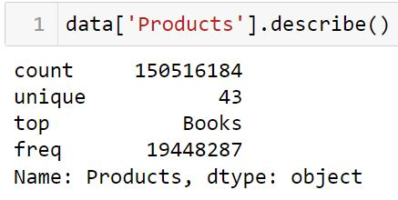
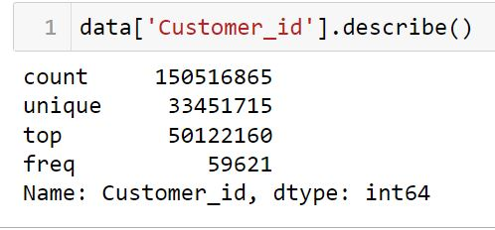
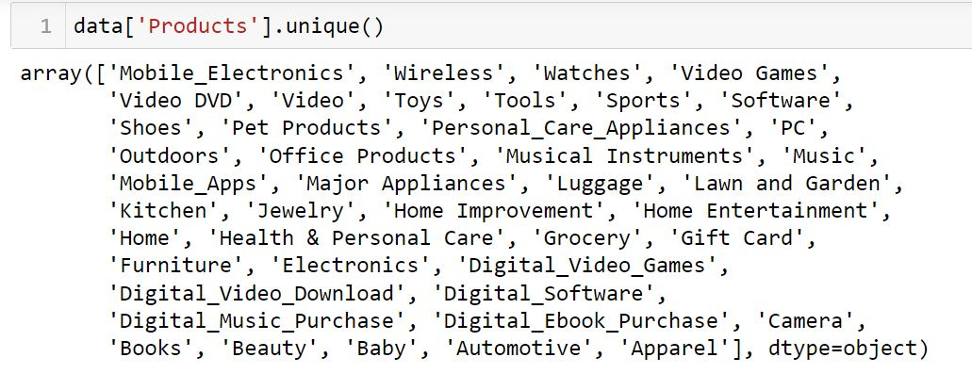
ASSOCIATION MINING PROCESS
After generating the raw transaction file in csv format, we generated some statistics about our dataset.

Slide 10
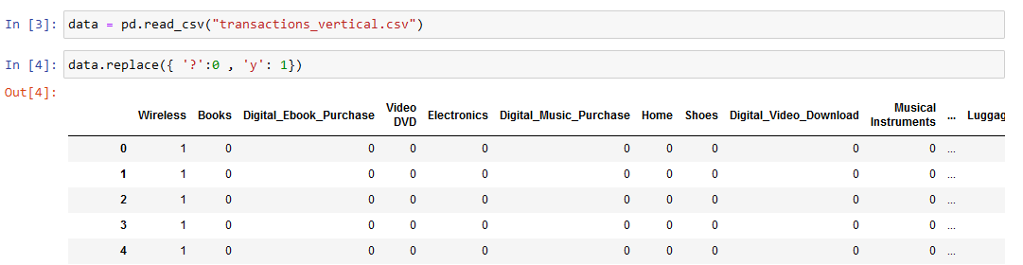
ASSOCIATION MINING PROCESS
Created a python script which converts the raw transaction file into a format that would be used for the FP growth algorithm which would be applied both in WEKA and Python.
The team experienced some memory challenges and unable to run the whole file successfully using libraries such as pandas and numpy.
Some modifications were made to the python script in order to successfully convert the file into the required format for both python and WEKA without the use of libraries like pandas and numpy.

Slide 11
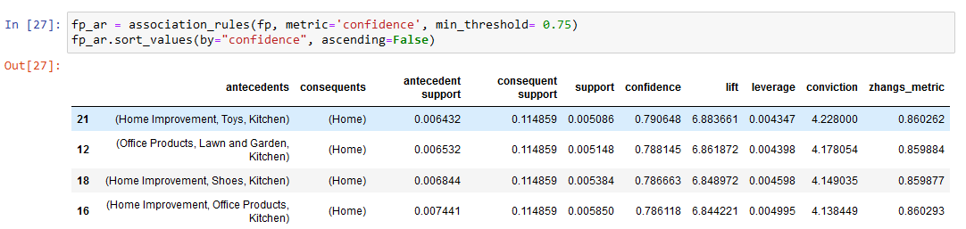
ASSOCIATION MINING PROCESS – FINAL RESULTS
We created a new python script which used the transaction_vertical.csv file as input data and applied FP growth algorithm using python.
The metrics values used to evaluate the association rules were setup.
The metric used for the associaition rules include:
Support: The min_support was set up to 0.005
Confidence: The confidence value was set up to 0.75
The final count of Association rules generated were 24.
The lift value shows the strength of the association rule by combining the support and the confidence value of the association rule.

Slide 12
STRONG ASSOCIATION RULES
 | antecedents | consequents | antecedent support | consequent support | support | confidence | lift
21 | (Home Improvement, Toys, Kitchen) | (Home) | 0.006432 | 0.114859 | 0.005086 | 0.790648 | 6.883661
3 | (Wireless, Office Products, Electronics) | (PC) | 0.008748 | 0.134393 | 0.006789 | 0.775998 | 5.774118
1 | (PC, Outdoors, Electronics) | (Wireless) | 0.006746 | 0.172106 | 0.005139 | 0.761851 | 4.426633

Slide 13
Metrics for Evaluating Association Rules
In association rule mining, several metrics are commonly used to evaluate the quality and importance of the discovered association rules. It is important to note that the appropriate choice of metric will depend on the specific goals and requirements of the application.
Support: It is a measure of how frequently an item or itemset appears in the dataset. It is calculated as the number of transactions containing the item(s) divided by the total number of transactions in the dataset. High support indicates that an item or itemset is common in the dataset, while low support indicates that it is rare.
Confidence: It is a measure of the strength of the association between two items. It is calculated as the number of transactions containing both items divided by the number of transactions containing the first item. High confidence indicates that the presence of the first item is a strong predictor of the presence of the second item.
Lift: It is a measure of the strength of the association between two items, taking into account the frequency of both items in the dataset. It is calculated as the confidence of the association divided by the support of the second item. Lift is used to compare the strength of the association between two items to the expected strength of the association if the items were independent.

Slide 14
OPPORTUNITIES IN ASSOCIATION MINING
Customer Segmentation: We can use the association mining information to tailor marketing campaigns and personalized recommendations to specific customer segments and increase Business Revenues.
Fraud Detection: We can also use association rule mining to detect fraudulent activity. For example, a credit card company might use association rule mining to identify patterns of fraudulent transactions, such as multiple purchases from the same merchant within a short period of time.
Recommendation systems: Association rule mining can be used to suggest items that a customer might be interested in based on their past purchases or browsing history. For example, a music streaming service might use association rule mining to recommend new artists or albums to a user based on their listening history.
Social network analysis: We can use association rule mining to identify patterns in social media data that can inform the analysis of social networks. For example, an analysis of Twitter data might reveal that users who tweet about a particular topic are also likely to tweet about other related topics, which could inform the identification of groups or communities within the network.

Slide 15
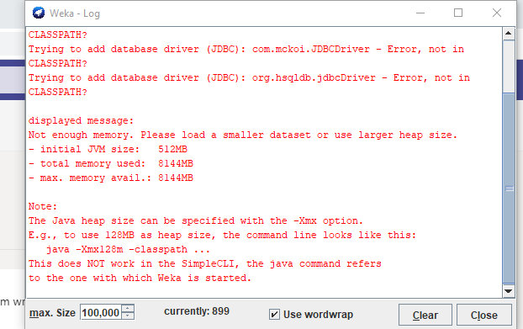
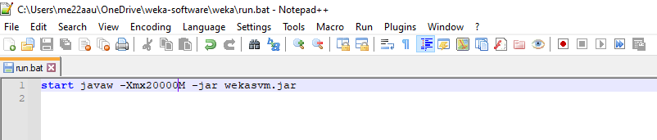
PROJECT LIMITATIONS/CHALLENGES
Use of review dataset from Amazon: We could only use the Amazon “Review” Dataset for the application of the association mining technique as the team could not access the actual Amazon dataset.
For the implementation of association mining techniques on large dataset, there is need for high machine specification for the generation and running of the python scripts and dataset.
For performance testing, the WEKA application crashed for over 5million transactions.
The WEKA memory (JAVA heap size) was upscaled but failed to run the file due to memory size.

Slide 16
CONCLUSION
Association rule mining is a valuable tool for data analysis and a powerful technique for discovering patterns and relationships within data. You can use association rule mining in multiple contexts to extract insights and understand the underlying structure of data.
However, it is important to choose the appropriate algorithm and set the right parameters, such as the minimum support and confidence thresholds, to obtain meaningful and accurate results.
There is not necessarily one overall metric that we can use to decide which rules to ‘officially’ accept or discard.
For the project, we can conclude that there are more than two product combinations as “antecedents” and a single “consequent” from the dataset.

Slide 17
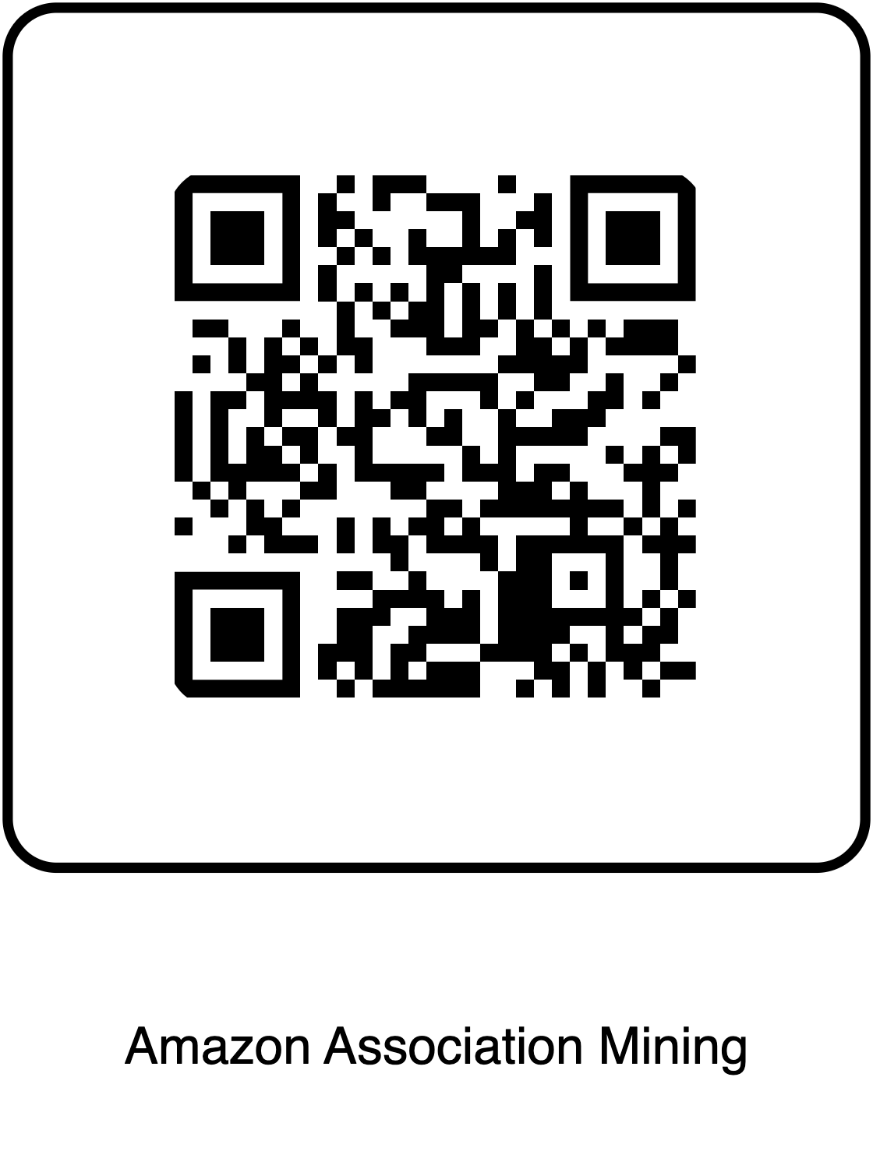
GITHUB PROFILE/LINK
https://github.com/elohom/DSPC_Amazon_Association_Min.git

